Slide 1
Plant leaf Disease detection Using CNN and TensorFlow(Phytora: Plant Health’s Future)
- BY Team SALAAR

Slide 2
Table of Contents
Team Members Roles and Responsibilities
Problem Statement
Project Description
Persons
Technologies
Project Schedule
Retrospective
Team Agreement
Wiki Link

Slide 3
01
Team Member Roles and Responsibilities

Slide 4
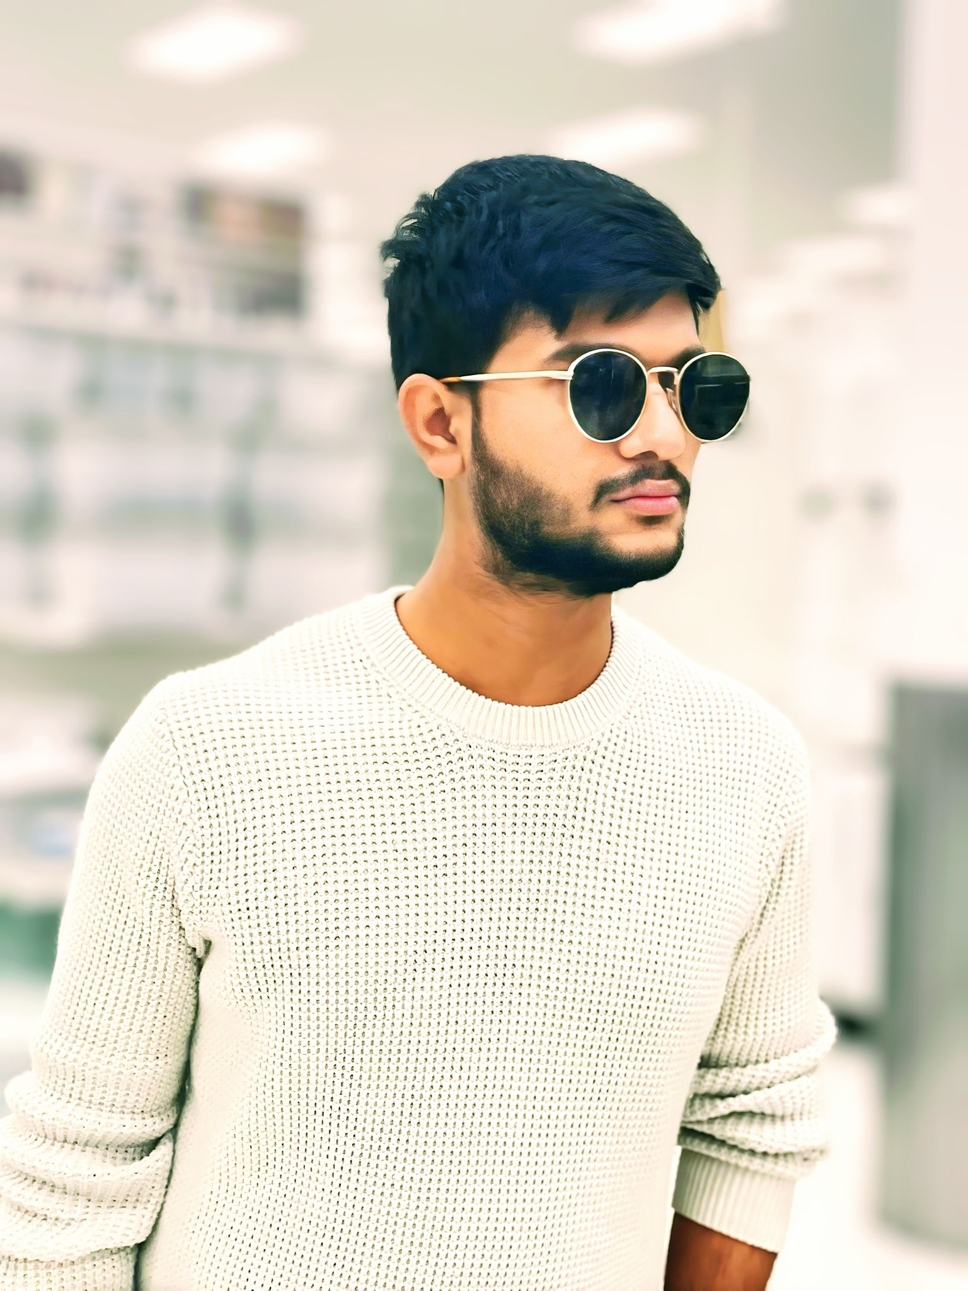
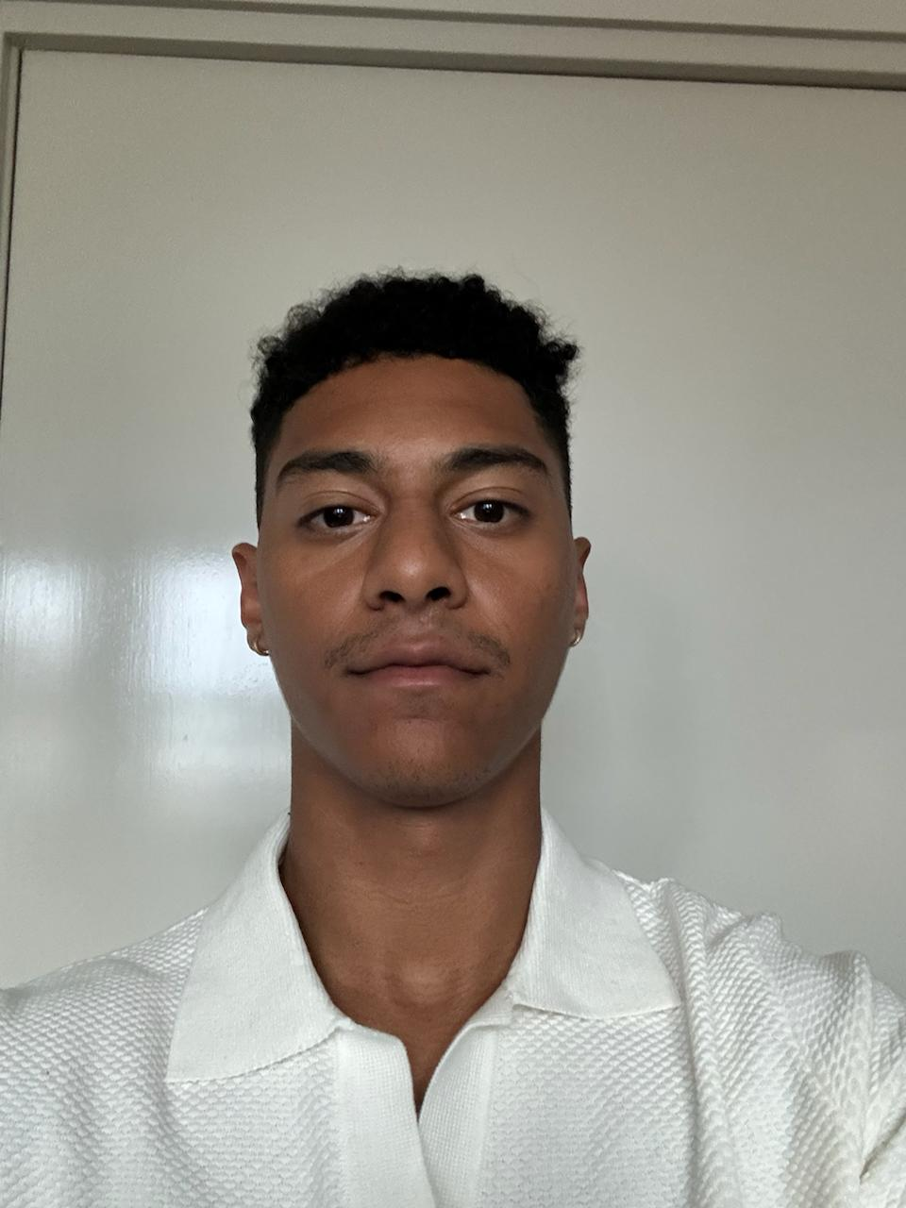
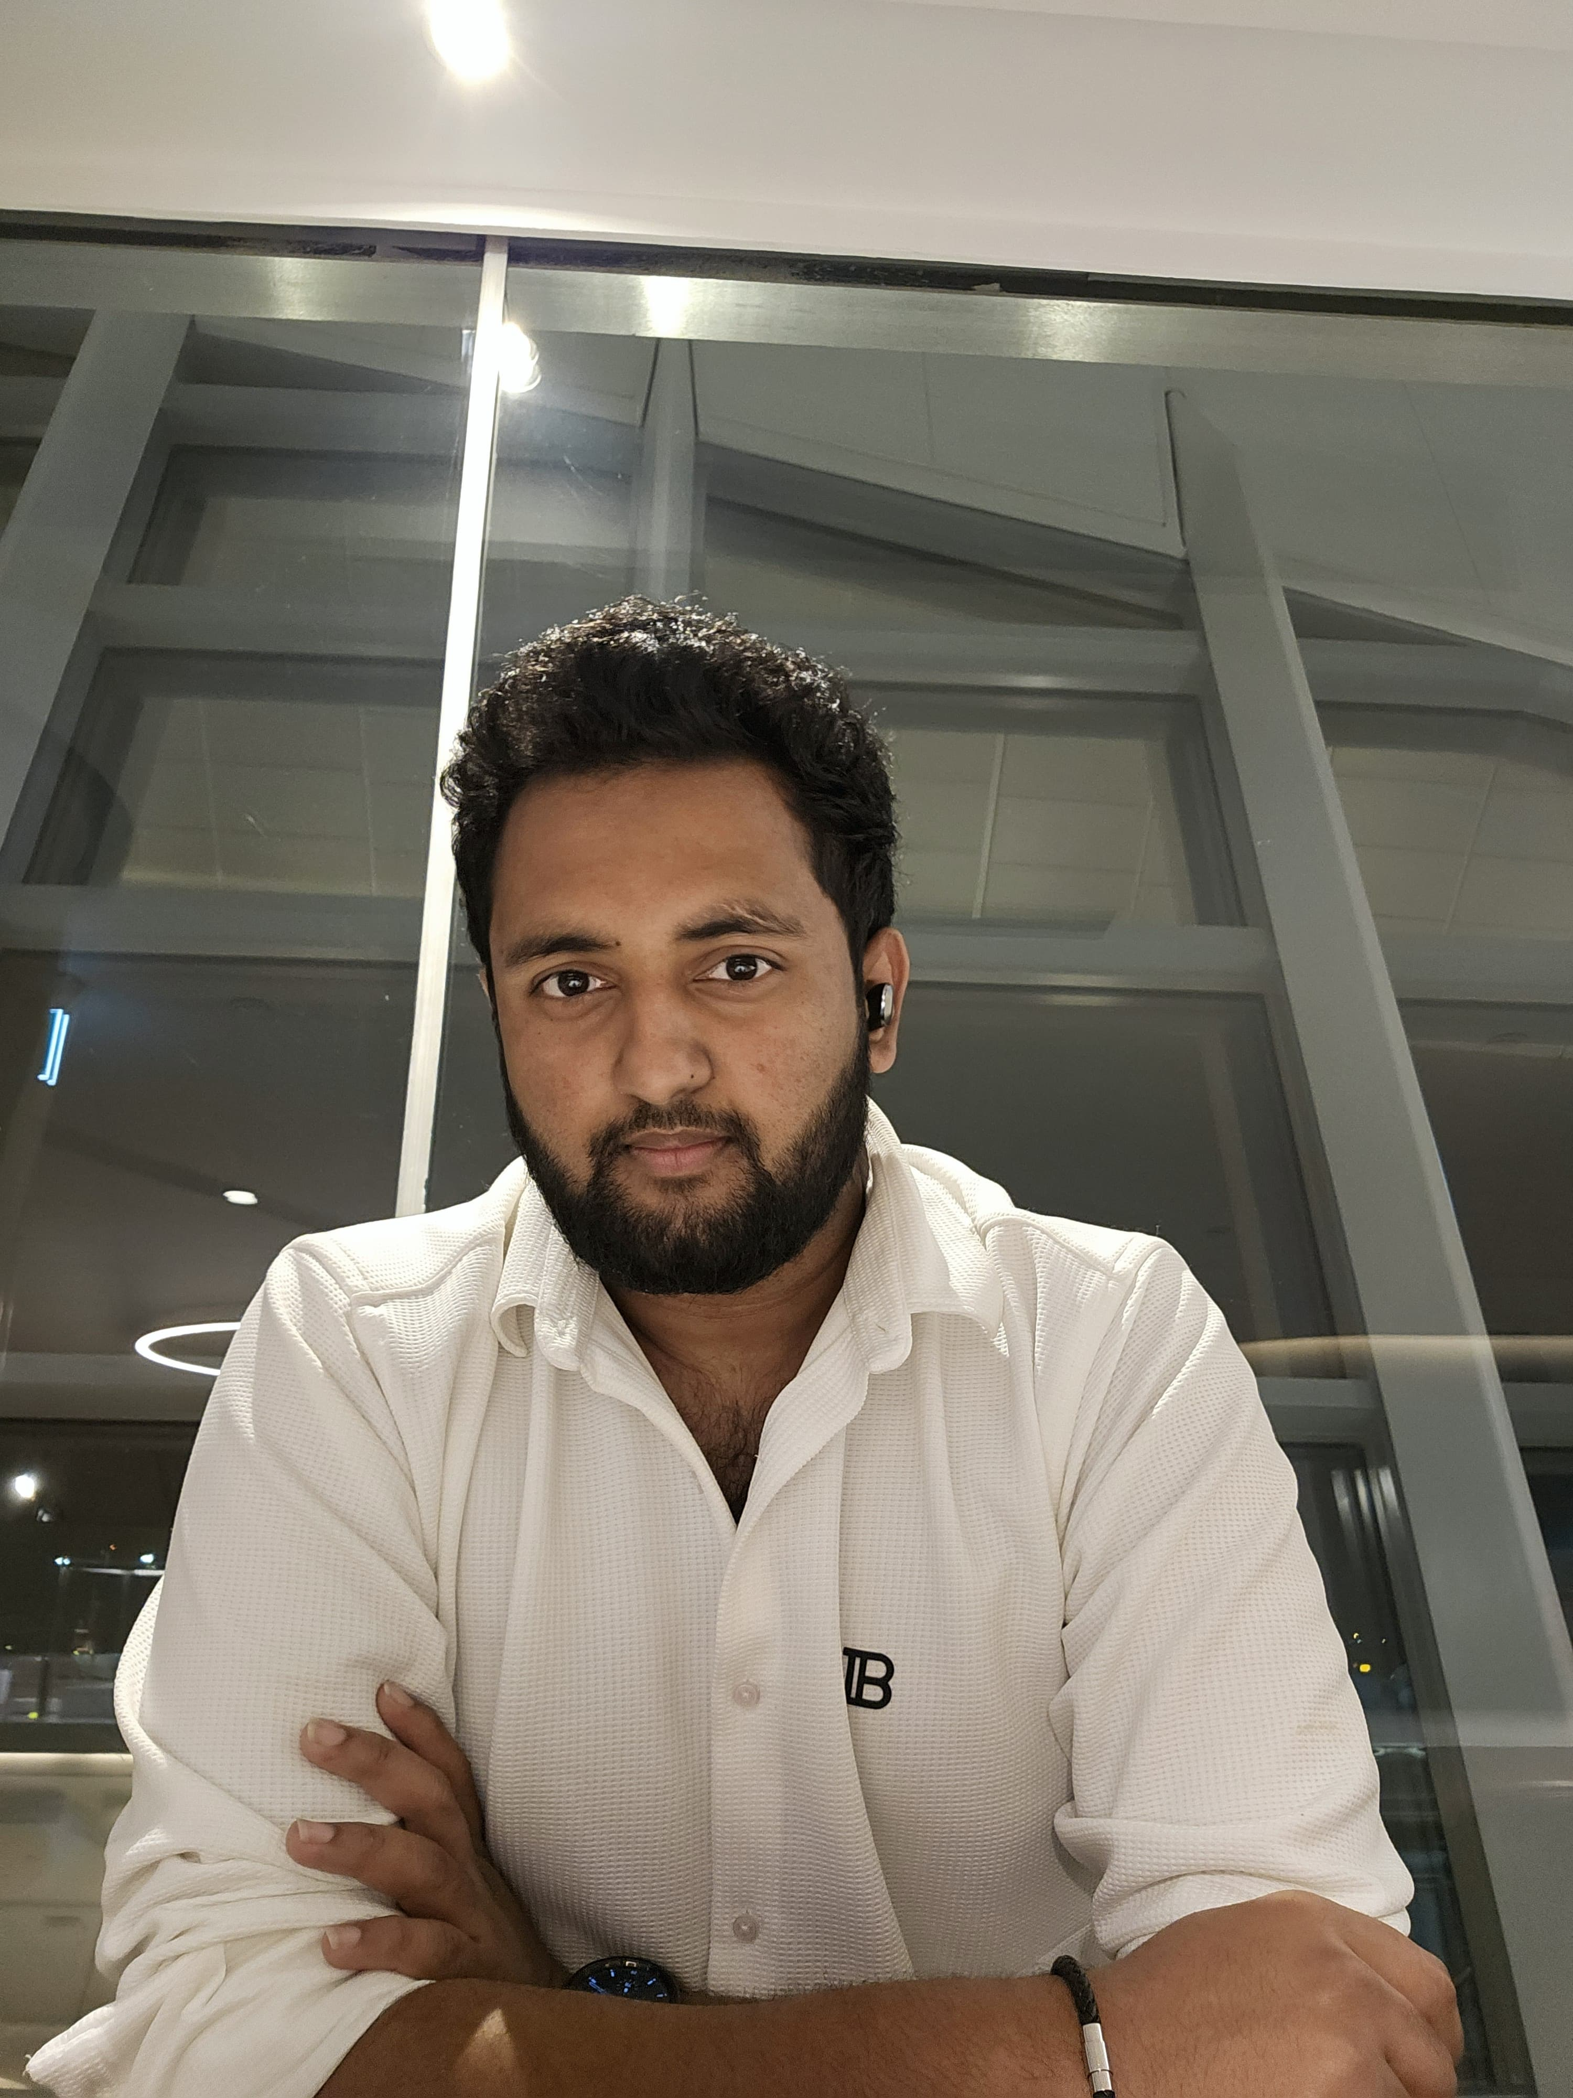
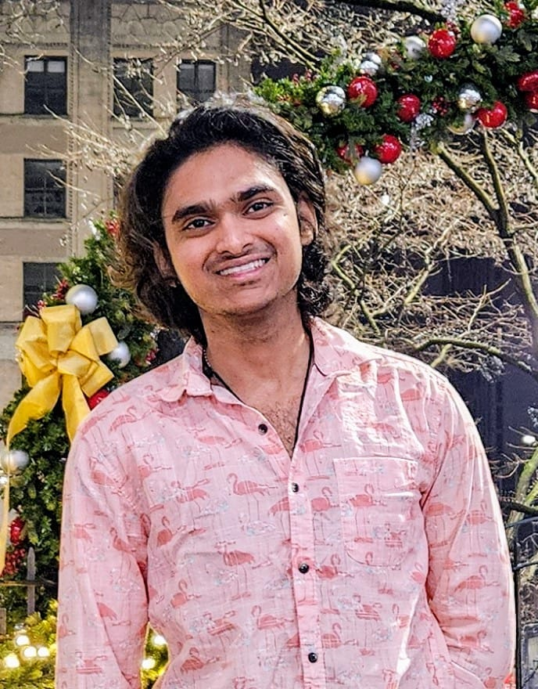
Team Members Roles and Responsibilities
Manoj Reddy Scrum Master
Paul Sr. Front End Developer
Krishna Kishore
Sr. Back End Developer & Team Lead
Gopi Krishna
Jr. Back End Developer

Slide 5
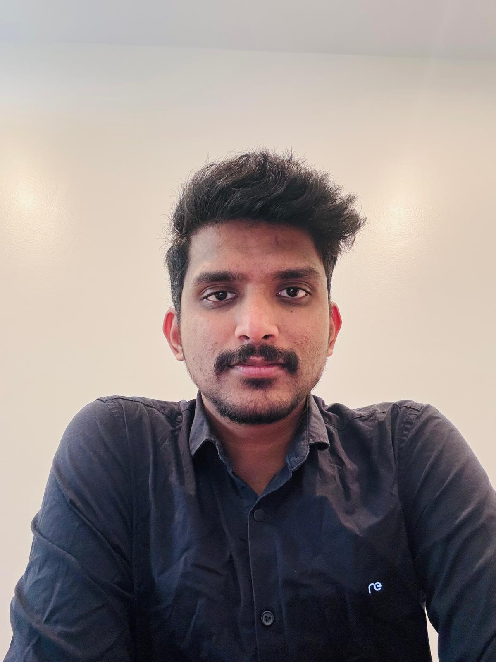
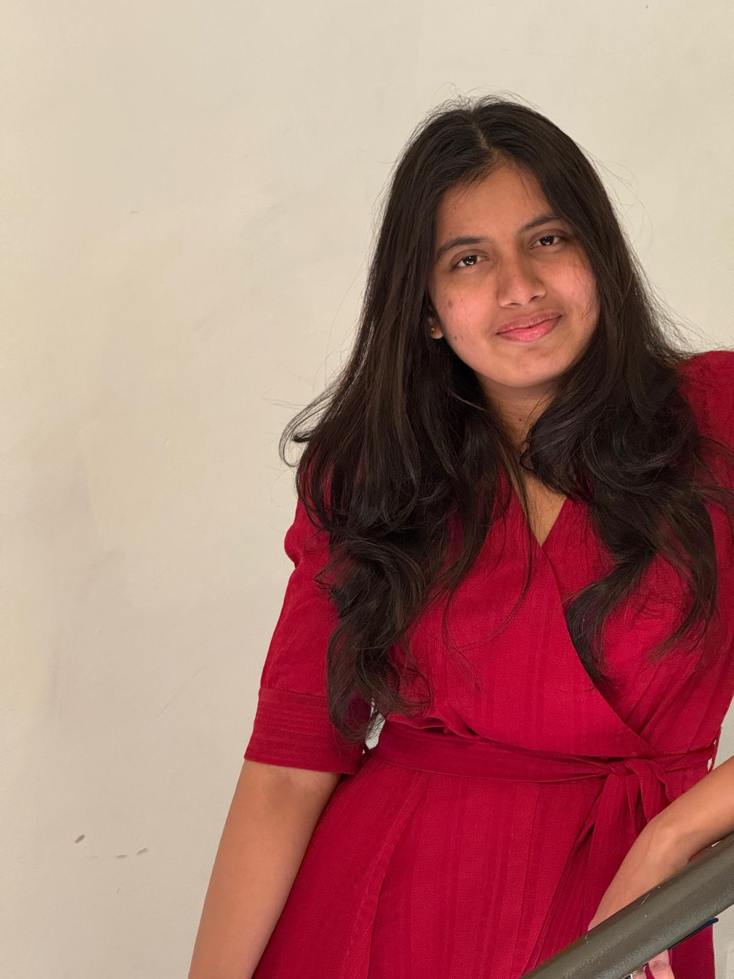
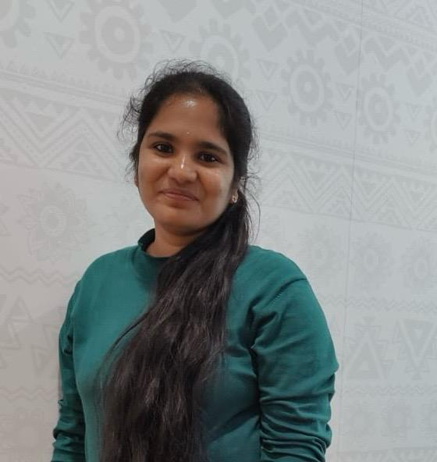
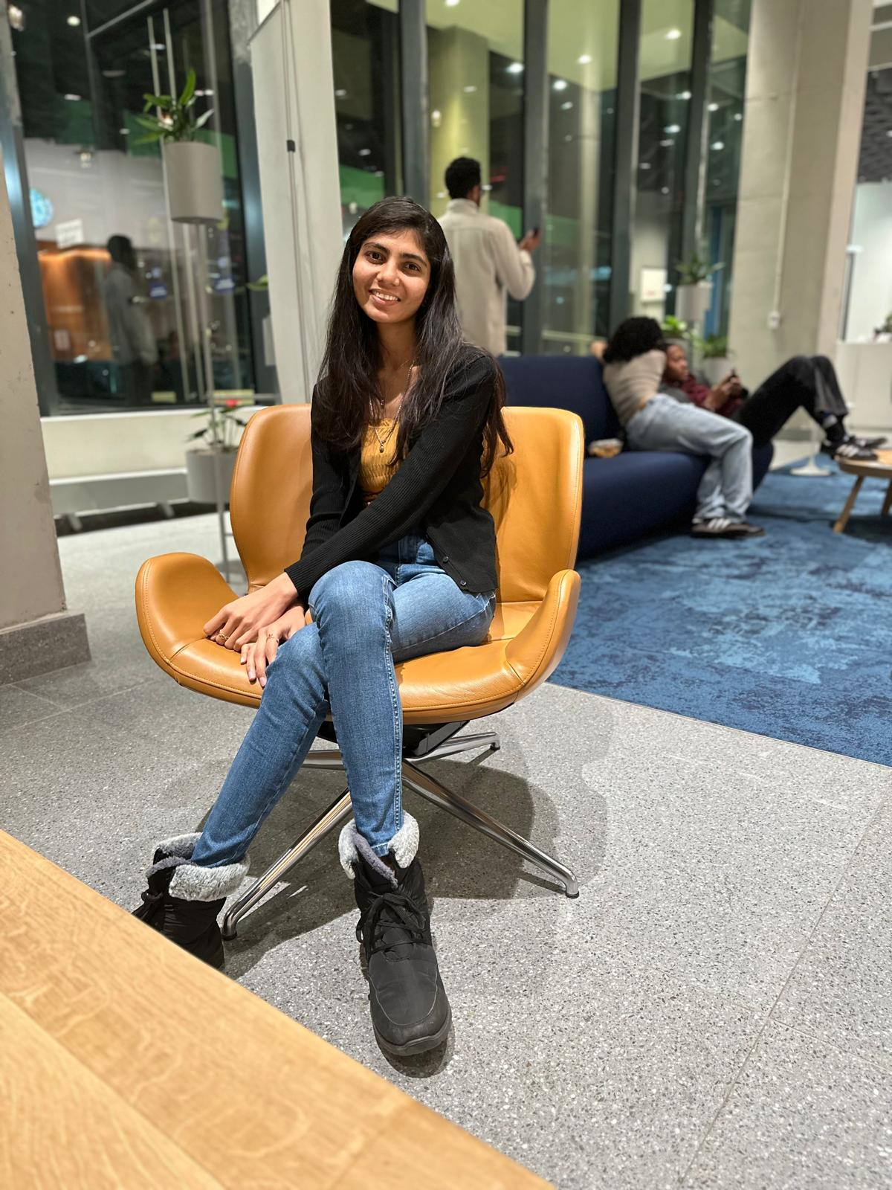
Karthik Back End QA
Sai Priya
Front End
Team Lead
Nikitha Frond-End QA
NagaLakshmi
Jr. Front End Developer

Slide 6
02
Problem Statement

Slide 7
Problem Statement
Apple trees are prone to diseases like scab and rust, impacting yield if not detected early. Traditional methods are costly and labor-intensive, while AI-powered CNNs offer faster, more accurate detection. However, challenges like background noise and variable disease appearance hinder accuracy. A robust deep learning model is needed to efficiently detect and classify apple diseases, ensuring timely intervention and reducing agricultural losses.

Slide 8
03
Project Description

Slide 9
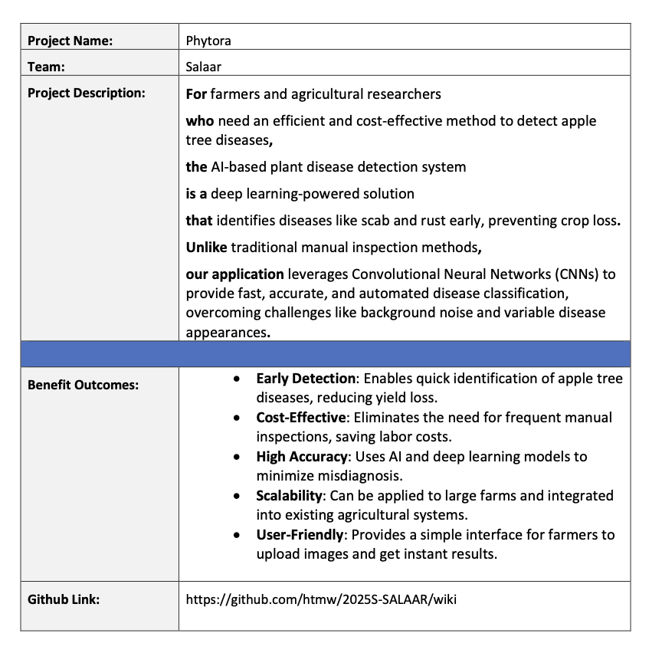
Project Description
Project Name: | Plant leaf Disease detection Using CNN and TensorFlow
Team: | SALAAR
Project Description: | Project helps the farmers to decide the better pesticide to be used for the farm with some clear and concise analysis done By Us For farmers and agriculturalists who face the hurdle of distinguishing and accessing treatment for plant leaf pathogens, the plant leaf disease detection application is a plant bug detection tool powered by machine learning that detects and categorically diagnoses plant ailments from leaf photographs. Unlike traditional inspection methods or straightforward image analyzing mobile applications, our application offers the means to provide a broader plant disease diagnostic scope, resulting in faster actions and enabling users to take action more effectively rather than protecting crops.
Benefit Outcomes: | Accelerated Disease Detection – Farmers can now easily and accurately diagnose plant-related diseases that are harmful to their crops within seconds. This means less time spent on manual checking and lots more time saved while waiting for lab reports. Increased Profits – Farmers can decrease crop losses by spending less time identifying and treating diseases, which results in less damage and more profitable harvests. Reduced Costs – Treating diseases effectively can be achieved through correct and early identifying disease detection which helps in utilizing less pesticide and saves money. Higher Resource Management – More precise disease detection means that resources such as water, fertilizers and pesticides can be more efficiently distributed, improving farm management systems. Better Yield Resilience – With effective intervention, plants thrive and produce better crops that are not easily damaged and are more tough against diseases. Managed Scale Development – Users can expand their cultivation or apply to different fields due to minimal difficulties and the android’s ability to examine a large range of crops and diseases. Insight from Data – Farmers can receive accurate information on the trends of their crops due to the app collecting, storing and analyzing data over time which helps them to make better decisions about the crops they grow in the future. Less Reliance on Labor – Because of the automated disease detection, there is less need for trained workers during the farming process, which streamlines the farming process.
Github Link: | https://github.com/htmw/2025S-SALAAR/wiki

Slide 10
04
Personas

Slide 11

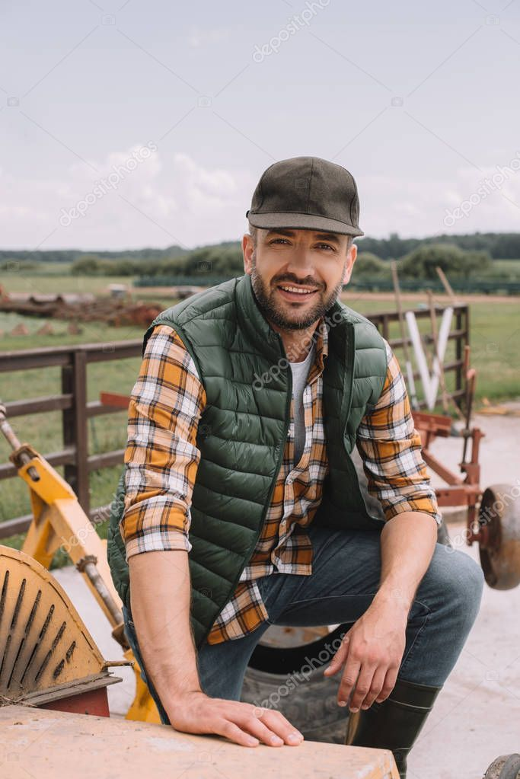
PERSONAS
Farmer – John Carter
Age: 45
Occupation: Apple Orchard Owner
Location: Washington, USA
Technology Proficiency: Low to Moderate
Farming Experience: 20+ years
Pain Points:
Relies on manual disease inspection, which is time-consuming and error-prone.
Finds it hard to differentiate between early-stage symptoms of apple scab and rust.
High costs for hiring agricultural experts and consultants.
Crop losses due to late detection of infections, leading to lower profits.
Needs & Expectations:
A mobile-friendly app where he can take a picture of infected leaves and receive instant results.
An AI-driven advisory system suggesting treatment solutions for different disease stages.
Offline functionality, since farms often have poor internet connectivity.
A cost-effective solution that doesn’t require expensive hardware.
How Our Product Helps:
Automated disease detection reduces guesswork and ensures timely intervention.
Provides step-by-step guidance on disease management, reducing dependency on external experts.
Saves time and labor costs, increasing farm productivity and yield.

Slide 12
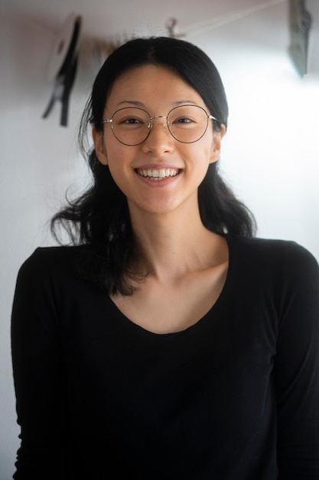
Agricultural Researcher – Dr. Emmy Zhao
Age: 38
Occupation: Plant Pathologist & Researcher
Location: California, USA
Technology Proficiency: High
Research Focus: AI-based plant disease prediction, crop disease resistance
Pain Points:
Needs large, high-quality datasets to improve disease classification models.
Variability in disease symptoms (color, shape, size) makes model training challenging.
Lack of real-time field data for studying disease spread patterns.
Difficulty in integrating AI-based tools with existing agricultural research systems.
Needs & Expectations:
Access to a labeled image dataset for improving AI accuracy.
A cloud-based dashboard with insights into disease occurrences across different regions.
Ability to contribute research data and collaborate with other scientists.
A customizable AI model that can be adapted for different crops and environmental conditions.
How Our Product Helps:
Provides real-time disease detection data, aiding in research and policy recommendations.
Offers a machine-learning training platform for researchers to refine detection algorithms.
Helps predict disease outbreaks, leading to more proactive agricultural strategies.

Slide 13
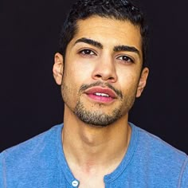
Agri-Tech Startup Founder – Michael Rodriguez
Age: 32
Occupation: CEO of a Smart Farming Startup
Location: Texas, USA
Technology Proficiency: High
Business Focus: AI-driven farm automation, precision agriculture
Pain Points:
Farmers are hesitant to adopt AI-based solutions due to trust issues and cost concerns.
Needs a scalable AI model that can integrate with existing smart farming hardware.
Difficulty in monetizing AI-based agricultural solutions while keeping them affordable.
Requires accurate, real-world disease detection data to improve product effectiveness.
Needs & Expectations:
A lightweight AI model that can be embedded in farm drones and IoT devices.
A subscription-based business model that balances affordability and profitability.
Market validation data to demonstrate AI’s effectiveness in reducing crop losses.
A seamless API to integrate disease detection with smart irrigation and pesticide control systems.
How Our Product Helps:
Provides real-time analytics and reporting tools for farm management.
Enables precision agriculture, optimizing pesticide use and reducing costs.

Slide 14
05
Technologies

Slide 15




Tools & Technologies
TensorFlow is a software library for
machine learning and
artificial intelligence.
https://www.tensorflow.org/
.
A versatile, high-level programming language.
https://www.python.org/
Tensor Flow
Python
Scikit-learn is probably the most useful
library for machine learning in Python.
https://scikit-learn.org/stable/
Streamlit For building interactive
web applications. https://streamlit.io/
Scikit
Stream lit

Slide 16




Cont..
Visual Studio Code for
Development
https://code.visualstudio.com
Jira for project management and issue tracking
https://www.atlassian.com
VS Code
Jira
Anaconda for Python-based machine learning IDE
https://www.anaconda.com/
My SQL Cluster enables users to meet the database challenges of next generation https://www.mysql.com/
Anaconda

Slide 17


Cont..
Allows developers to create, store, manage, and share their code
https://github.com/
Working together is easier
with Microsoft Teams
https://www.microsoft.com/en-us/microsoft-teams/group-chat-software

Slide 18
06
Algorithms

Slide 19
Algorithms
Our system utilizes EfficientNet, a state-of-the-art CNN model, for highly accurate and optimized plant disease detection. EfficientNet balances speed and accuracy by scaling depth, width, and resolution efficiently. Transfer learning enhances performance, while FastAPI enables real-time predictions, ensuring fast, precise, and resource-efficient disease identification for farmers and researchers.

Slide 20
07
Project Schedule

Slide 21
Project Schedule
Sprint 0: Initialization & Planning
Sprint 1: UI & Model Training
Sprint 2: Full Integration & Testing
Sprint 3: Optimization & Deployment

Slide 22
08
Team Working Agreement

Slide 23
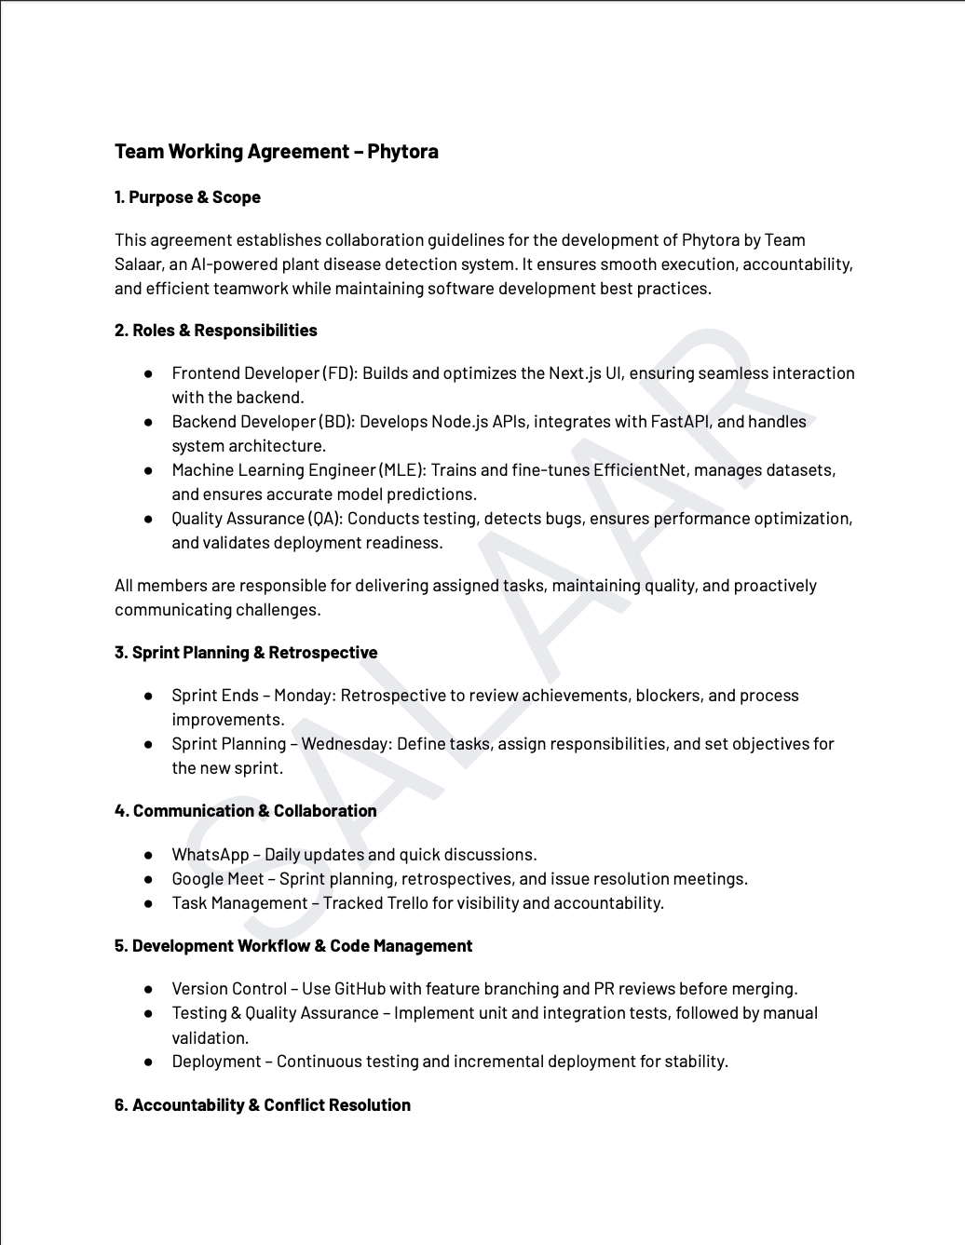
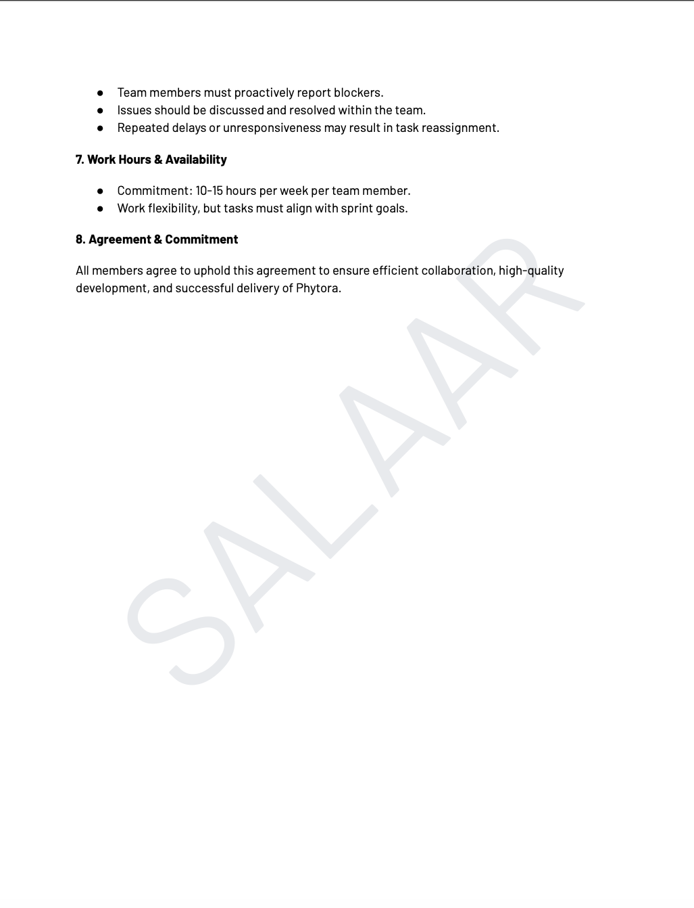

Slide 24
09
Retrospective

Slide 25
Retrospective
What Went Well?
Team Formation & Role Clarity
Manoj - Scrum Master - Organized roles in the team.
Sai Priya Frontend Lead & Krishna Kishore Backend Lead - Smooth Coordination
Jira & Git Setup Completed
Manoj - Set up Jira with backlog items.
Paul & Naga Lakshmi (Frontend), Krishna Kishore & Gopi Krishna (Backend) - Set up the Git repository.
Daily Scrum Calls Established
10:00 PM calls were initiated. Most of the team members updated about the progress in Jira before the meeting.
Project & Personas Finalized
Sai Priya added Farmer and Agricultural Expert personas in Jira.
Presentation Video Created & Uploaded
Sai Priya and Arpula Nikitha - Frontend QA designed the video.
Paul and Karthik - Backend QA uploaded and checked it on Git.

Slide 26
Cont..
Areas of Improvement
Jira Task Clarity
Some tasks were too broad and needed better breakdown.
Action: Manoj and Sai Priya will refine task definitions in Sprint 1.
Delayed Peer Reviews
Some pull requests were not reviewed on time.
Action: Arpula Nikitha and Karthik will enforce 24-hour review deadlines.
Git Collaboration Issues
Merge conflicts occurred due to an unclear branching strategy.
Action: Paul and Krishna Kishore will create a Git workflow guide.
Scrum Call Participation
Gopi Krishna and Naga lakshmi have forgotten to update Jira before certain calls.
Action: The members should update Jira before 9.30 PM daily.
Presentation Video Quality
More structure of script required before recording.
Action: The content would be reviewed before recording by Sai Priya and Paul.

Slide 27
Sprint 1 Action Plan
Smoothen Jira Workflow
Manoj and Sai Priya will ensure tasks are well-defined with clear acceptance criteria.
Standardize Git Workflow
Paul and Krishna Kishore will document the branching strategy: main → dev → feature-branch.
Increase Scrum Discipline
Manoj will enforce 15-minute standups.
Gopi Krishna All developers and QA members will update Jira before 9:30 PM.
Enforce Deadlines for Peer Review
Arpula Nikitha and Karthik will ensure pull requests are reviewed within 24 hours.
Improve Video and Documentation
Paul and Sai Priya will do a review before the videos go up.
Clearly, this retro summary encapsulates the essence of Sprint 0 and helps refine the execution at Sprint Please suggest any modification…..?

Slide 28
10
Wikipage

Slide 29
WikiPage
https://github.com/htmw/2025S-SALAAR/wiki

